Slide 1

Solar Output Prediction Using Weather Data
Phase II Presentation
Geeta Naga Sai Amrutha Chandaluri
Pavan Kumar Bellamkonda
Srija Adapa

Slide 2
Performing EDA
Step 1: Data Loading We combined 25 datasets spanning from 1998 to 2022 into a single dataframe for easier analysis.
Step 2: Data Cleaning We removed columns with null values or those that had minimal relevance to solar energy output prediction.
Step 3: Feature Engineering Out of the 24 original columns, we selected the 13 most relevant features for further analysis.
Step 4: Data Visualization To identify trends and insights, we created various visualizations. These graphs helped us better understand the relationships between weather variables and solar energy output, guiding us toward selecting the right machine learning models.

Slide 3
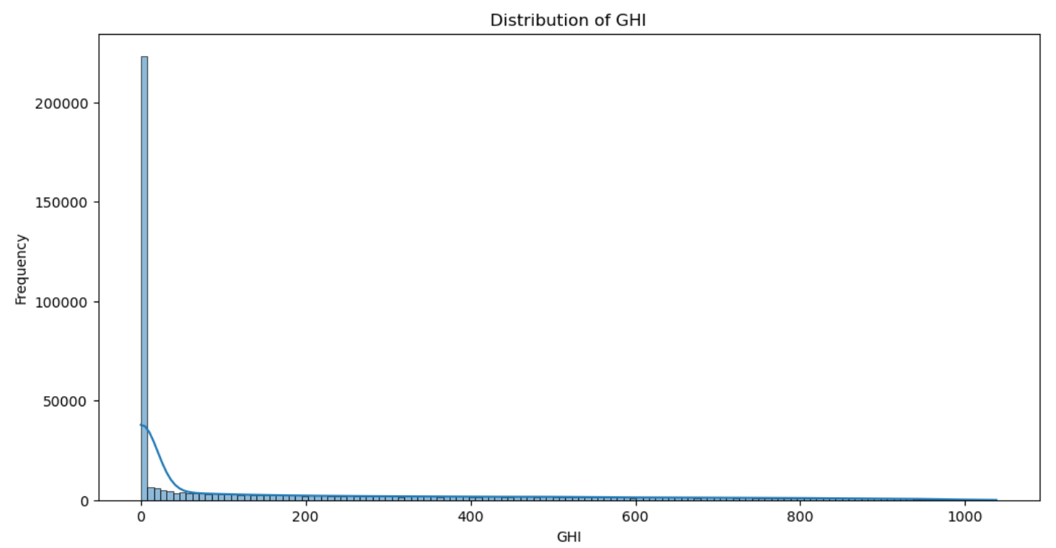
Distribution of GHI

Slide 4
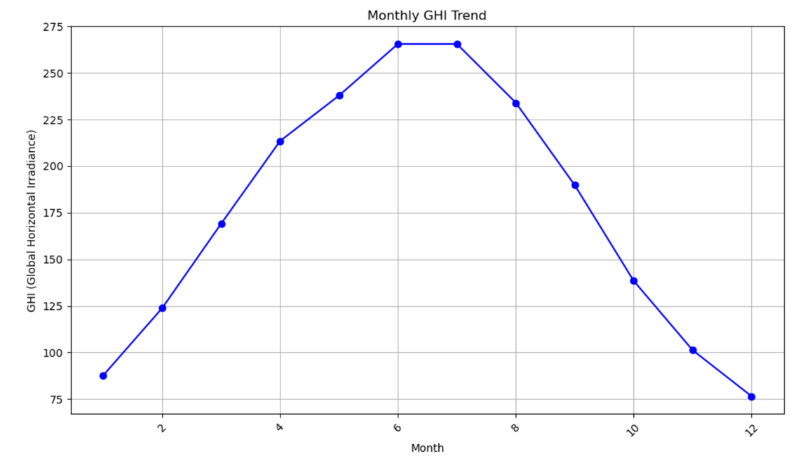
Pie Chart depicting Target variable
Monthly Analysis of GHI (Target Variable)

Slide 5
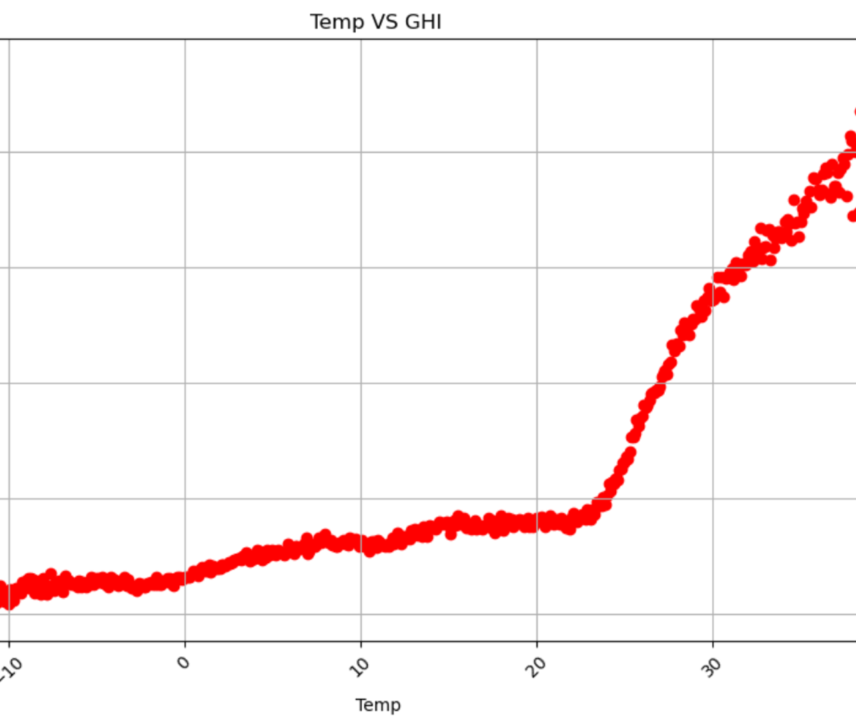
Temperature Vs GHI

Slide 6
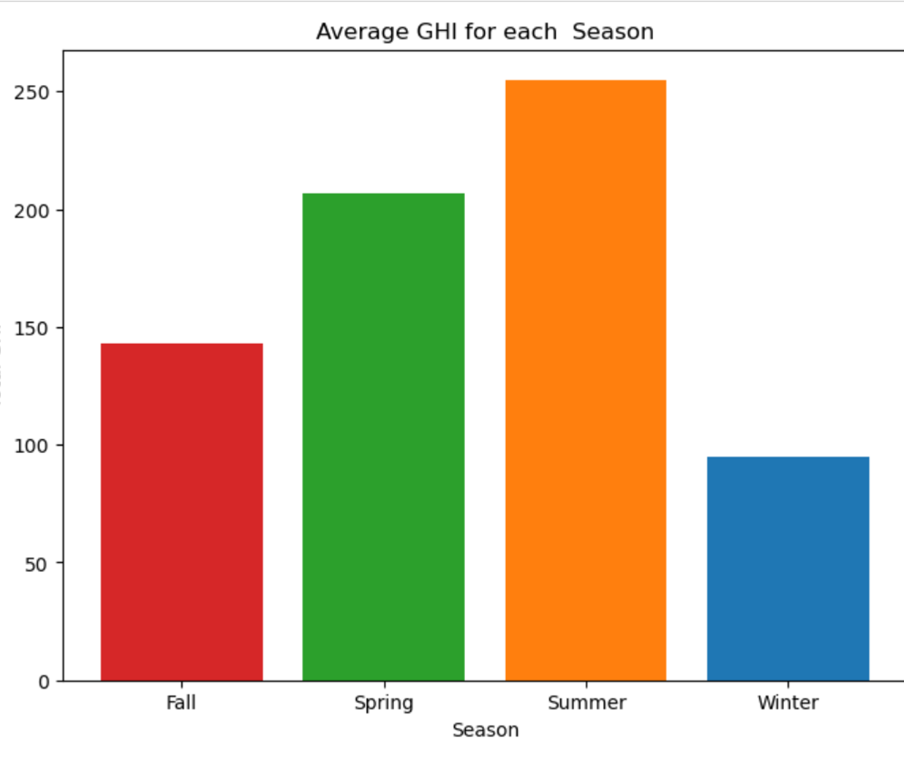
Seasonal Distribution of GHI
Added “Season” because solar output is dependent on Season
Summer has more GHI compared to Winter

Slide 7
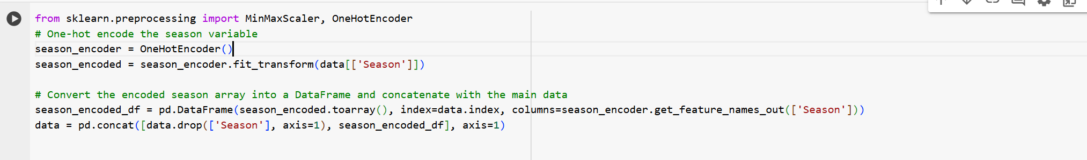
Data Transformations

Slide 8
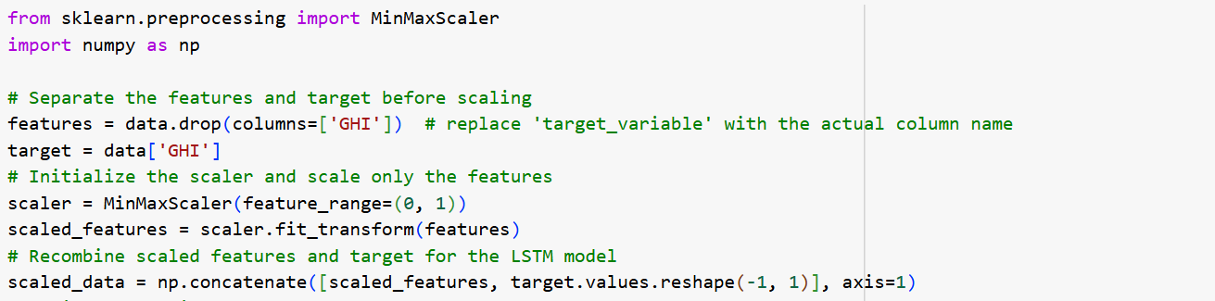
Data Transformations

Slide 9
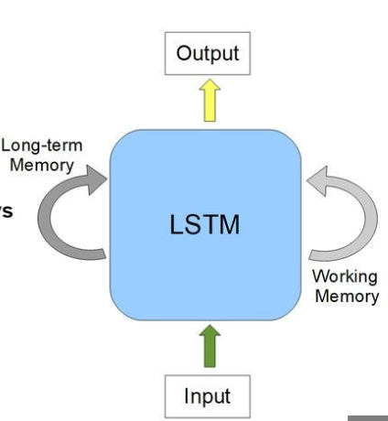
Long Short-Term Memory Network(LSTM)
Architecture:
Stacked LSTM layers (64 and 32 units) for capturing sequential weather patterns.
Dropout layers for preventing overfitting.
Dense Output Layer (1 unit) with linear activation for continuous GHI prediction.
Training:
Optimizer: Adam
Loss: Mean Squared Error (MSE)

Slide 10
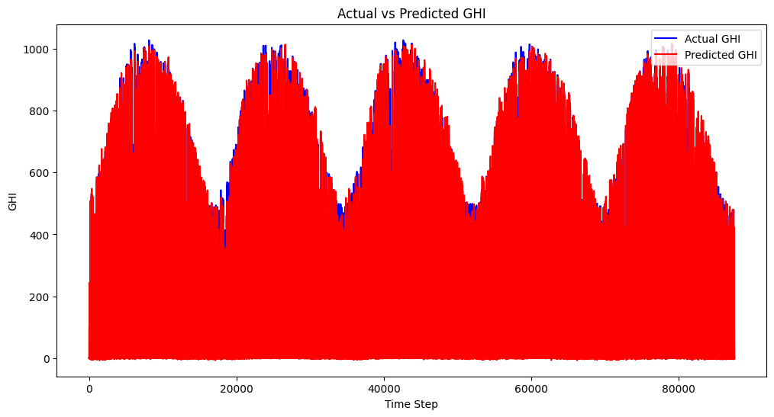
LSTM Model
Root Mean Squared Error (RMSE): 62.25284231331414
Mean Absolute Error (MAE): 28.04877239690534
Interpretation: Good capture of temporal
trends; potential for further tuning.

Slide 11
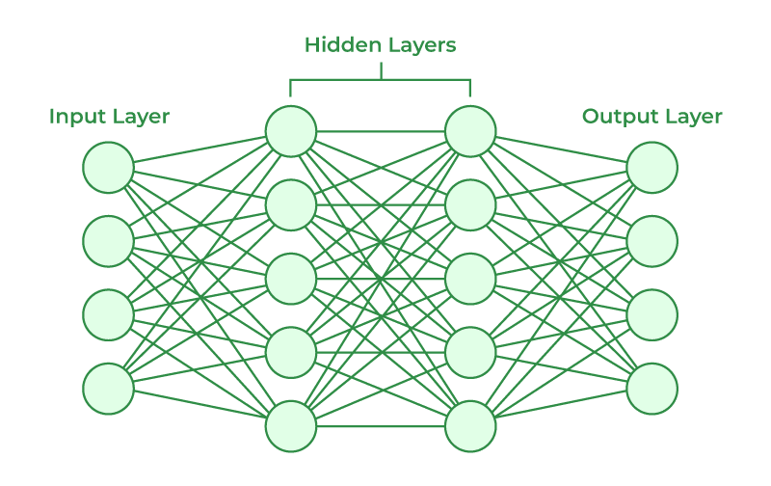
Artificial Neural Network(ANN)
Model Overview:
Architecture: Feedforward ANN with two hidden layers (64 and 32 neurons).
Activation: ReLU for hidden layers, Linear for output layer.
Optimization: Adam, with Mean Squared Error as the loss function.

Slide 12
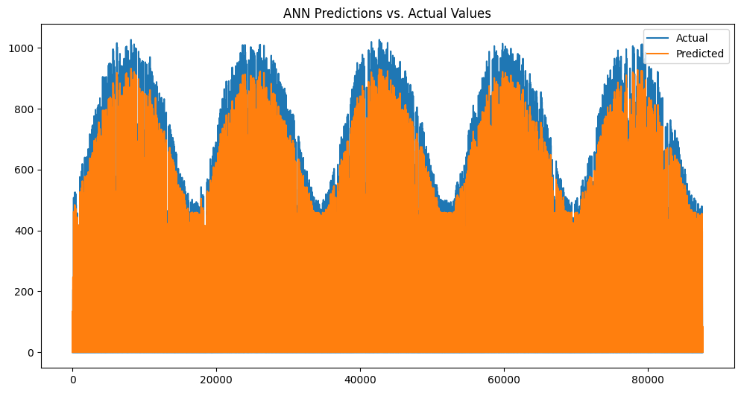
Artificial Neural Network(ANN)
Root Mean Squared Error (RMSE): 34.32
Mean Absolute Error (MAE): 20.90
Interpretation: These metrics indicate that the model effectively captures GHI trends.

Slide 13

THANK YOU

